Slide 1

MEDIA & THE PUBLIC
Week 10 Political persuasion
Ryan Wang
ryanyang@psu.edu

Slide 2
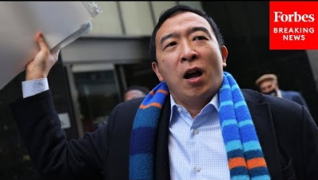

Slide 3
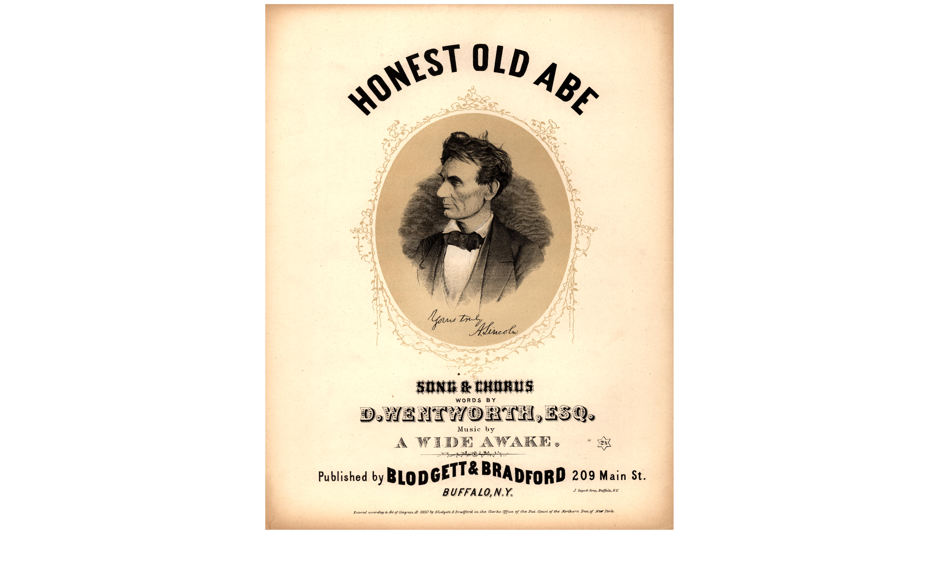
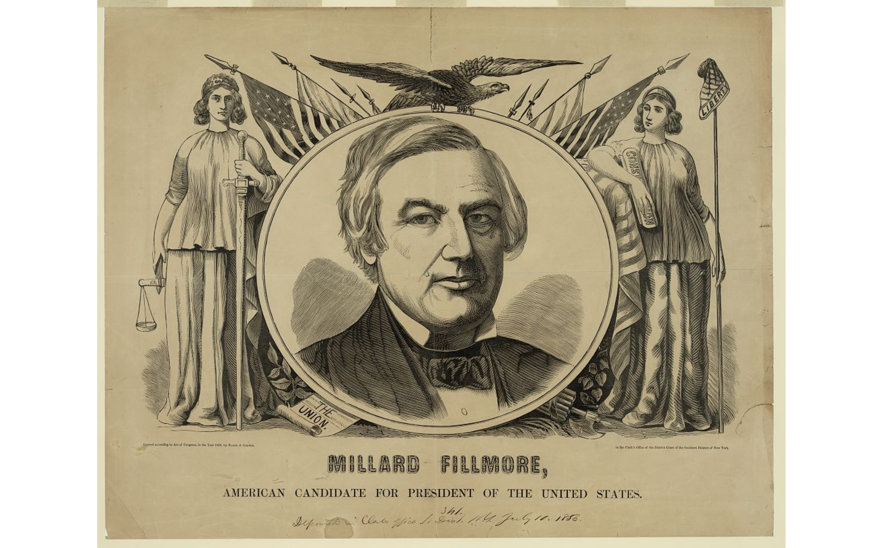
Notes:
advertising, theme songs, stump speeches, and even negative campaigning have been around since our country began, and each advance in technology since then has offered new opportunities for candidates to persuade voters. Study the campaign poster of Millard Fillmore from 1850. Would the figures of Justice and Liberty wearing gowns and tiaras surrounding Millard Fillmore sway a modern voter? Probably not, but notice the American flags in both of these posters. We certainly see that imagery in advertisements for candidates running in current presidential elections.

Slide 4
What is persuasion?
Definition (Simons, 1976, p. 21)
“Human communication that is designed to influence others by influence others by modifying their beliefs, values, or attitudes”
Characteristics (O’Keefe, 1999)
Persuasion involves a goal and the intent to achieve that goal on the part of the message sender
Communication is the means to achieve that goal
The message recipient must have free will
Goals (Perloff, 2020)
A change in someone’s attitudes, values and beliefs
Attitude: an individual’s general predisposition toward something as being good or bad, right or wrong, or negative or positive
Value: an individual’s perception of the usefulness, importance, or worth of something
Belief: the propositions or positions that an individual holds as true or false without positive knowledge or proof.
A change in behavior: get-out-the-vote (voter turnout)

Slide 5
Political persuasion for unlikely supporters?
Political persuasion
The act of influencing voters to choose your political platform over the oppositions through a series of tactics and practices.
Unlikely supporters? Framing matters!
Feinberg & Willer (2015): the way in which a political stance is framed influenced whether people supported it.
Two types of messages that supported an increase in military spending:
“national pride” and “unity at home and abroad”
help “the poor and disadvantaged achieve equal standing” through the military.
Conservatives tended to support an increase in military spending regardless of message, while liberals were more likely to support military spending if confronted with the second message.
Deliver your political messages in a way that appeals to the moral values of the people you are trying to persuade

Slide 6
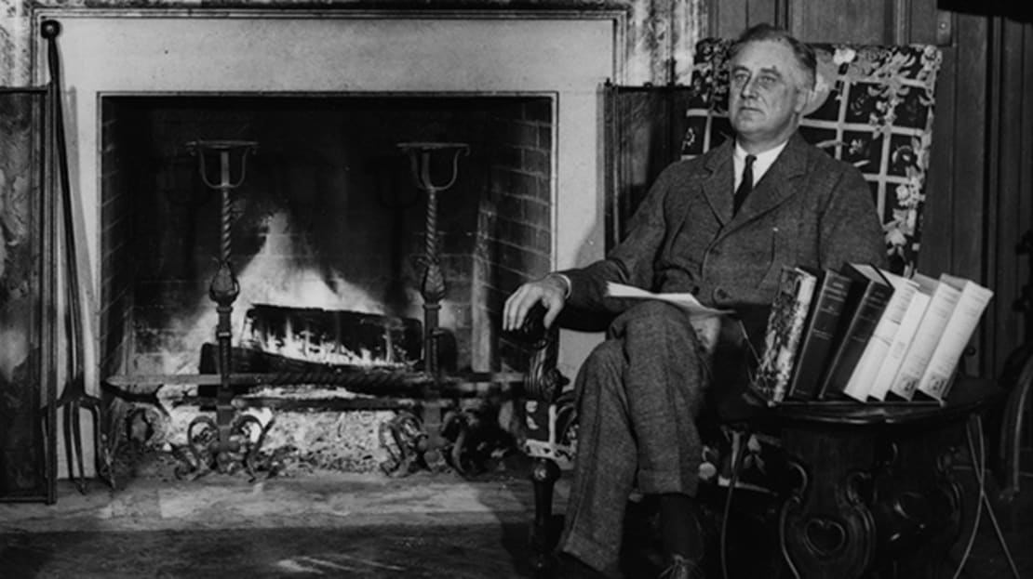
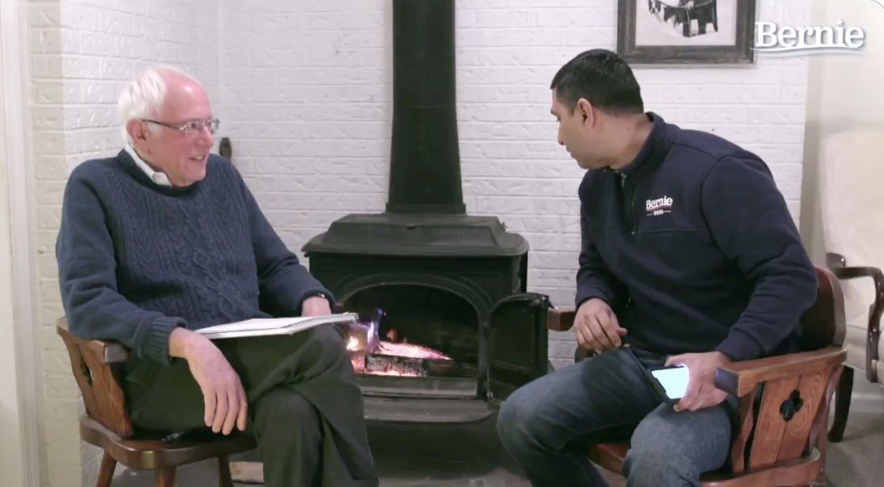
Political persuasion for undecided voters
Molding a candidate’s image
Goal: to influence the public perception of a candidate
The construction of a candidate’s image
The perception of a candidate’s personality traits.
The ability of voters to identify with the candidate on a personal level.
Leadership and oratory abilities displayed by the candidate.

Slide 7
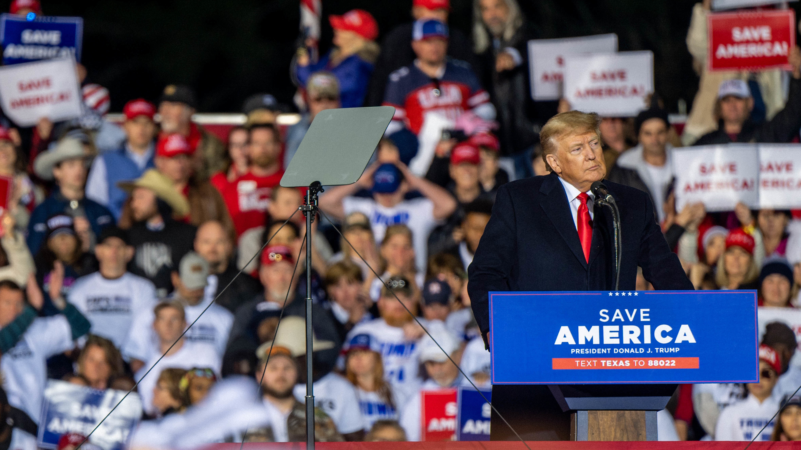
Political persuasion for undecided voters
Identifying and targeting an enemy
Goal: to unite voters towards a common goal (“us” vs. “other”)
“Create your enemy” (Machiavelli, 1532)
Out-group: a community, a policy issue, or the opposing candidate
Trump:
Usage of “nickname”
“Catchphrase”: Build the wall”; “Drain the swamp”

Slide 8
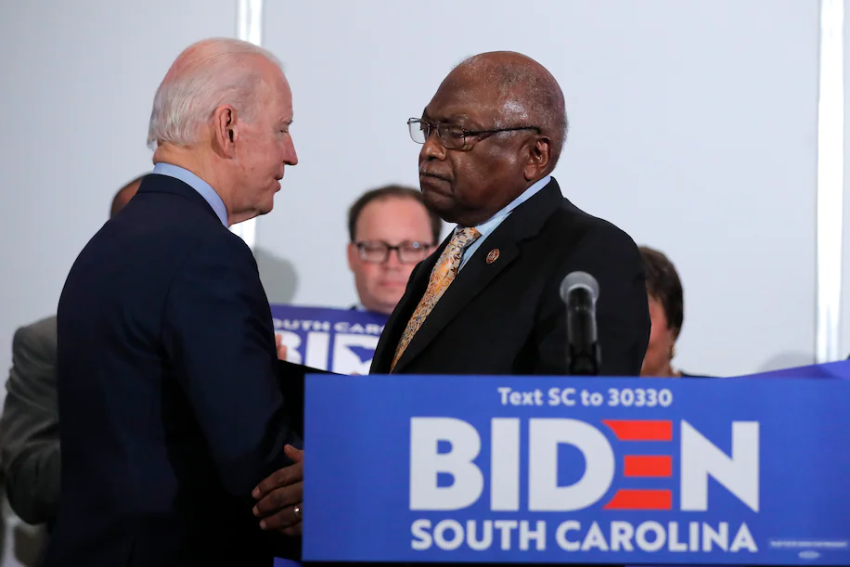
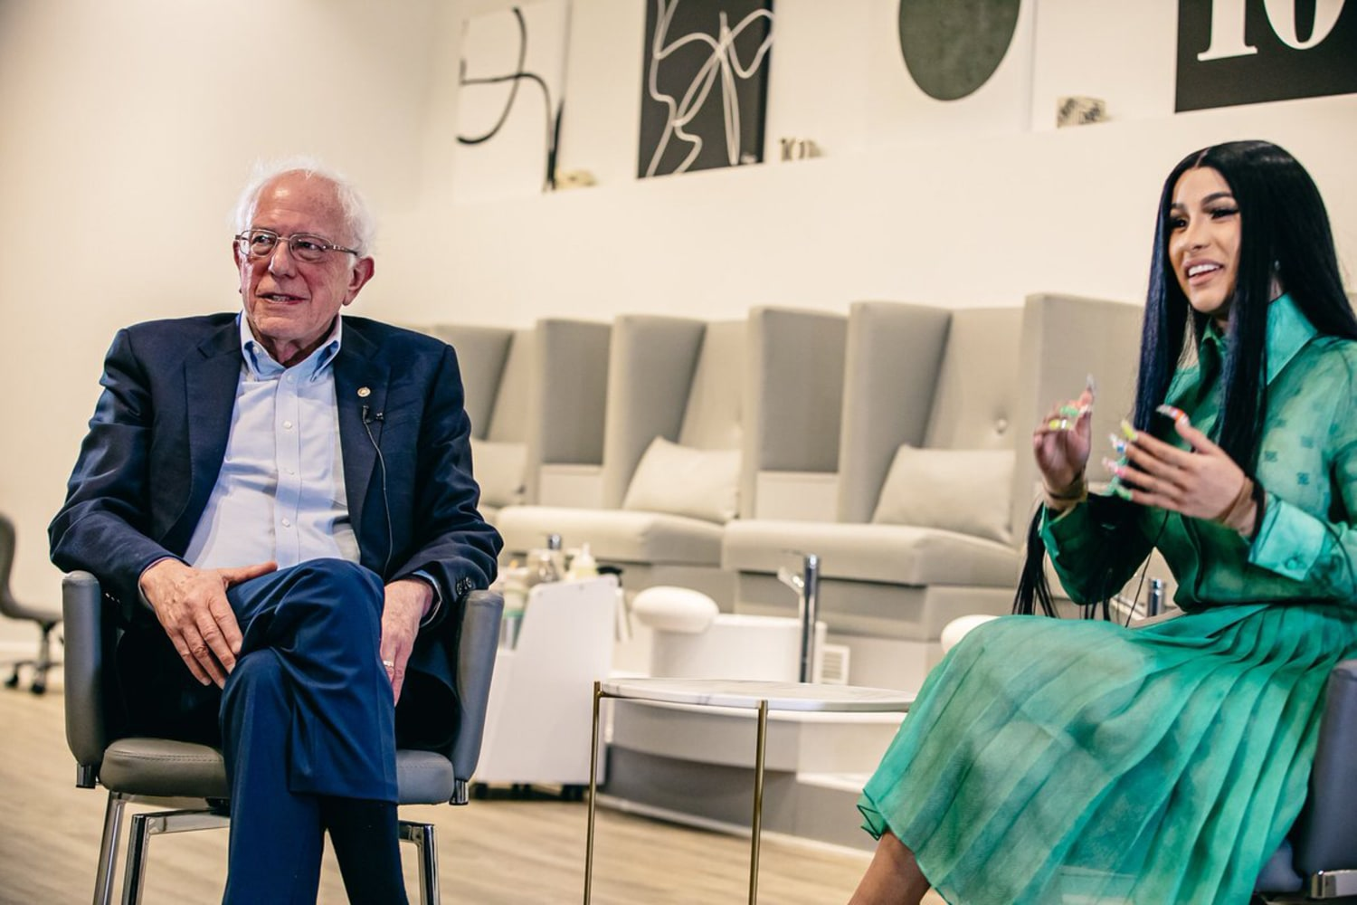
Political persuasion for undecided voters
Gathering endorsements
Goal: to build trust amongst voters through the help of a third party
Endorsements - trustworthiness
Political Parties
Politicians
Influencers
Community Leaders
Local unions
Local newspapers
Notes:
James Enos Clyburn is an American politician and retired educator serving as a Democratic member of the U.S. House of Representatives from South Carolina. He has served as House majority whip since 2019
Jim Clyburn’s endorsement of Joe Biden in South Carolina. 47% of South Carolina voters said it was either the most important factor in their vote or an important factor.

Slide 9
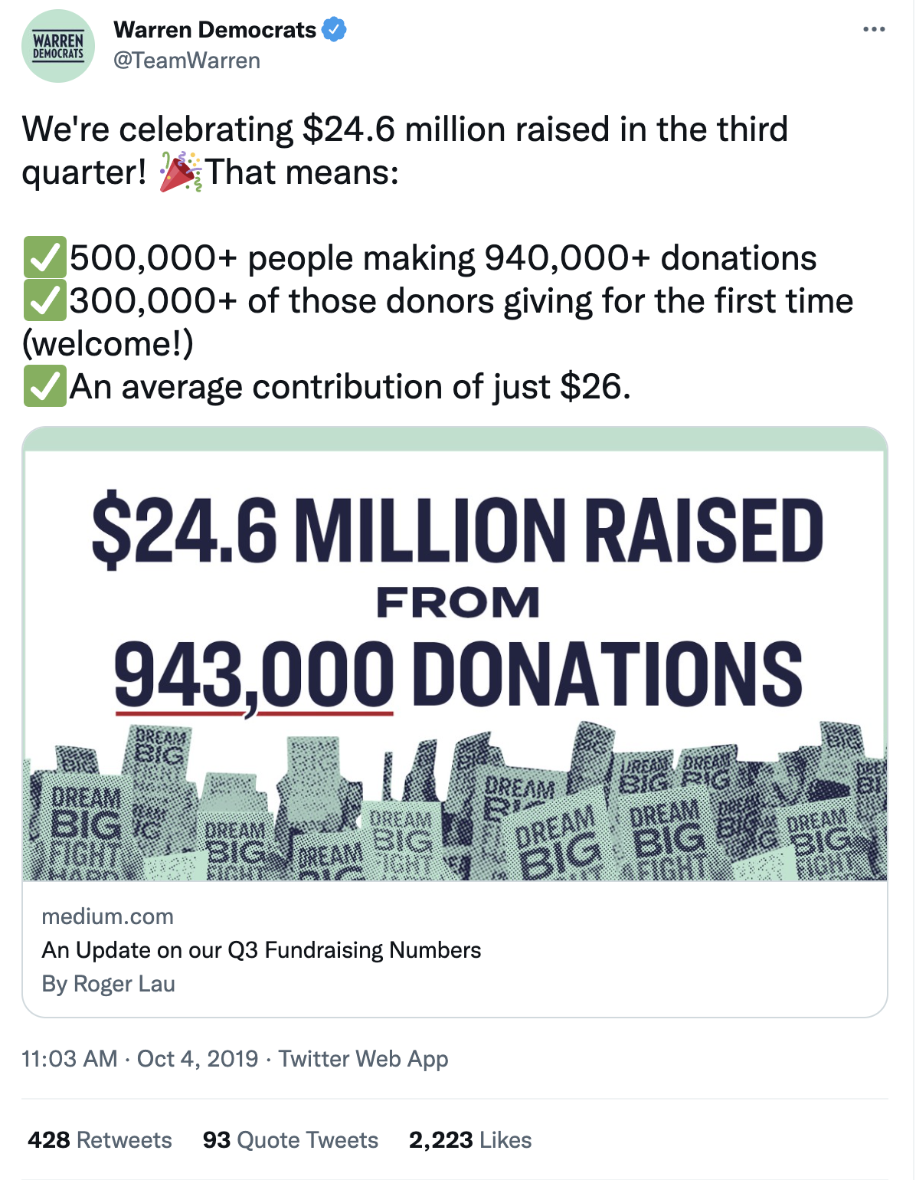
Political persuasion for undecided voters
Conveying favorable data
Goal: to communicate momentum for your campaign
Notes:
Take a look at Elizabeth Warren’s team talking about the fundraising numbers for their campaign on Twitter.
Reinforces your viewpoints and those of your base
Shows your chances of winning in a positive light

Slide 10
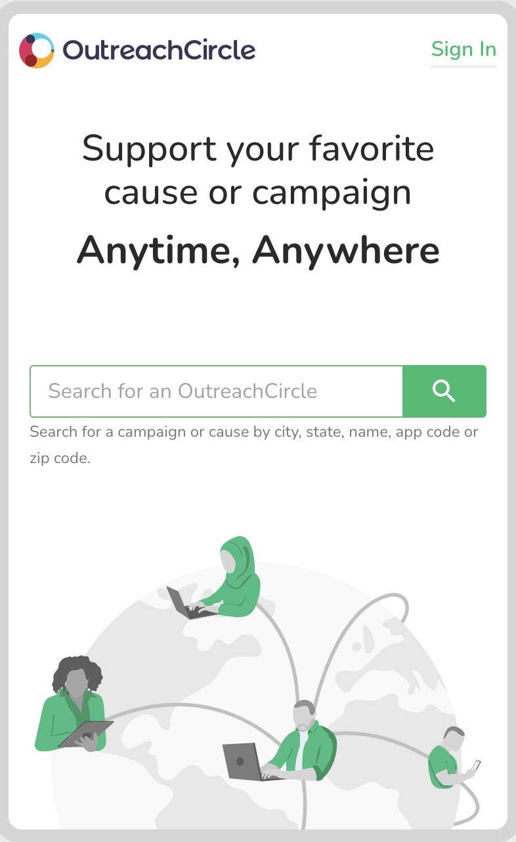
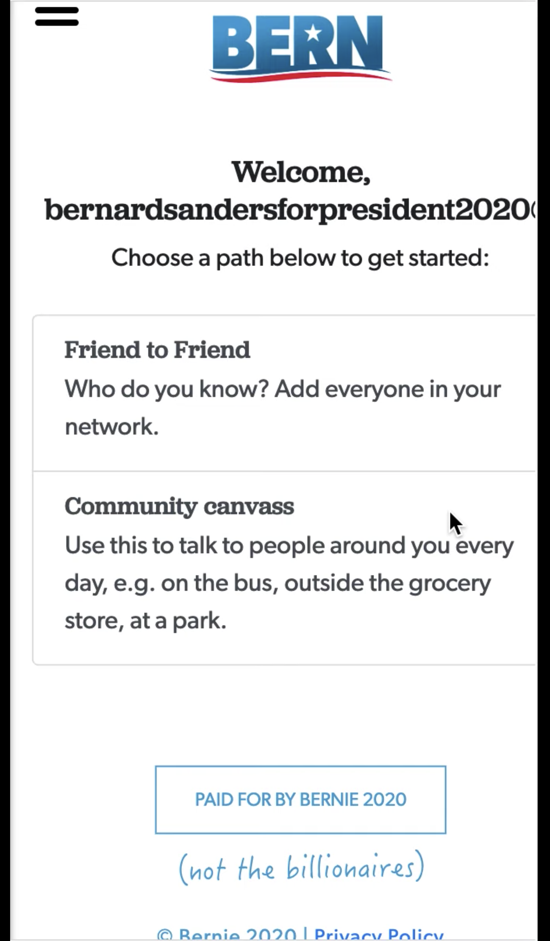
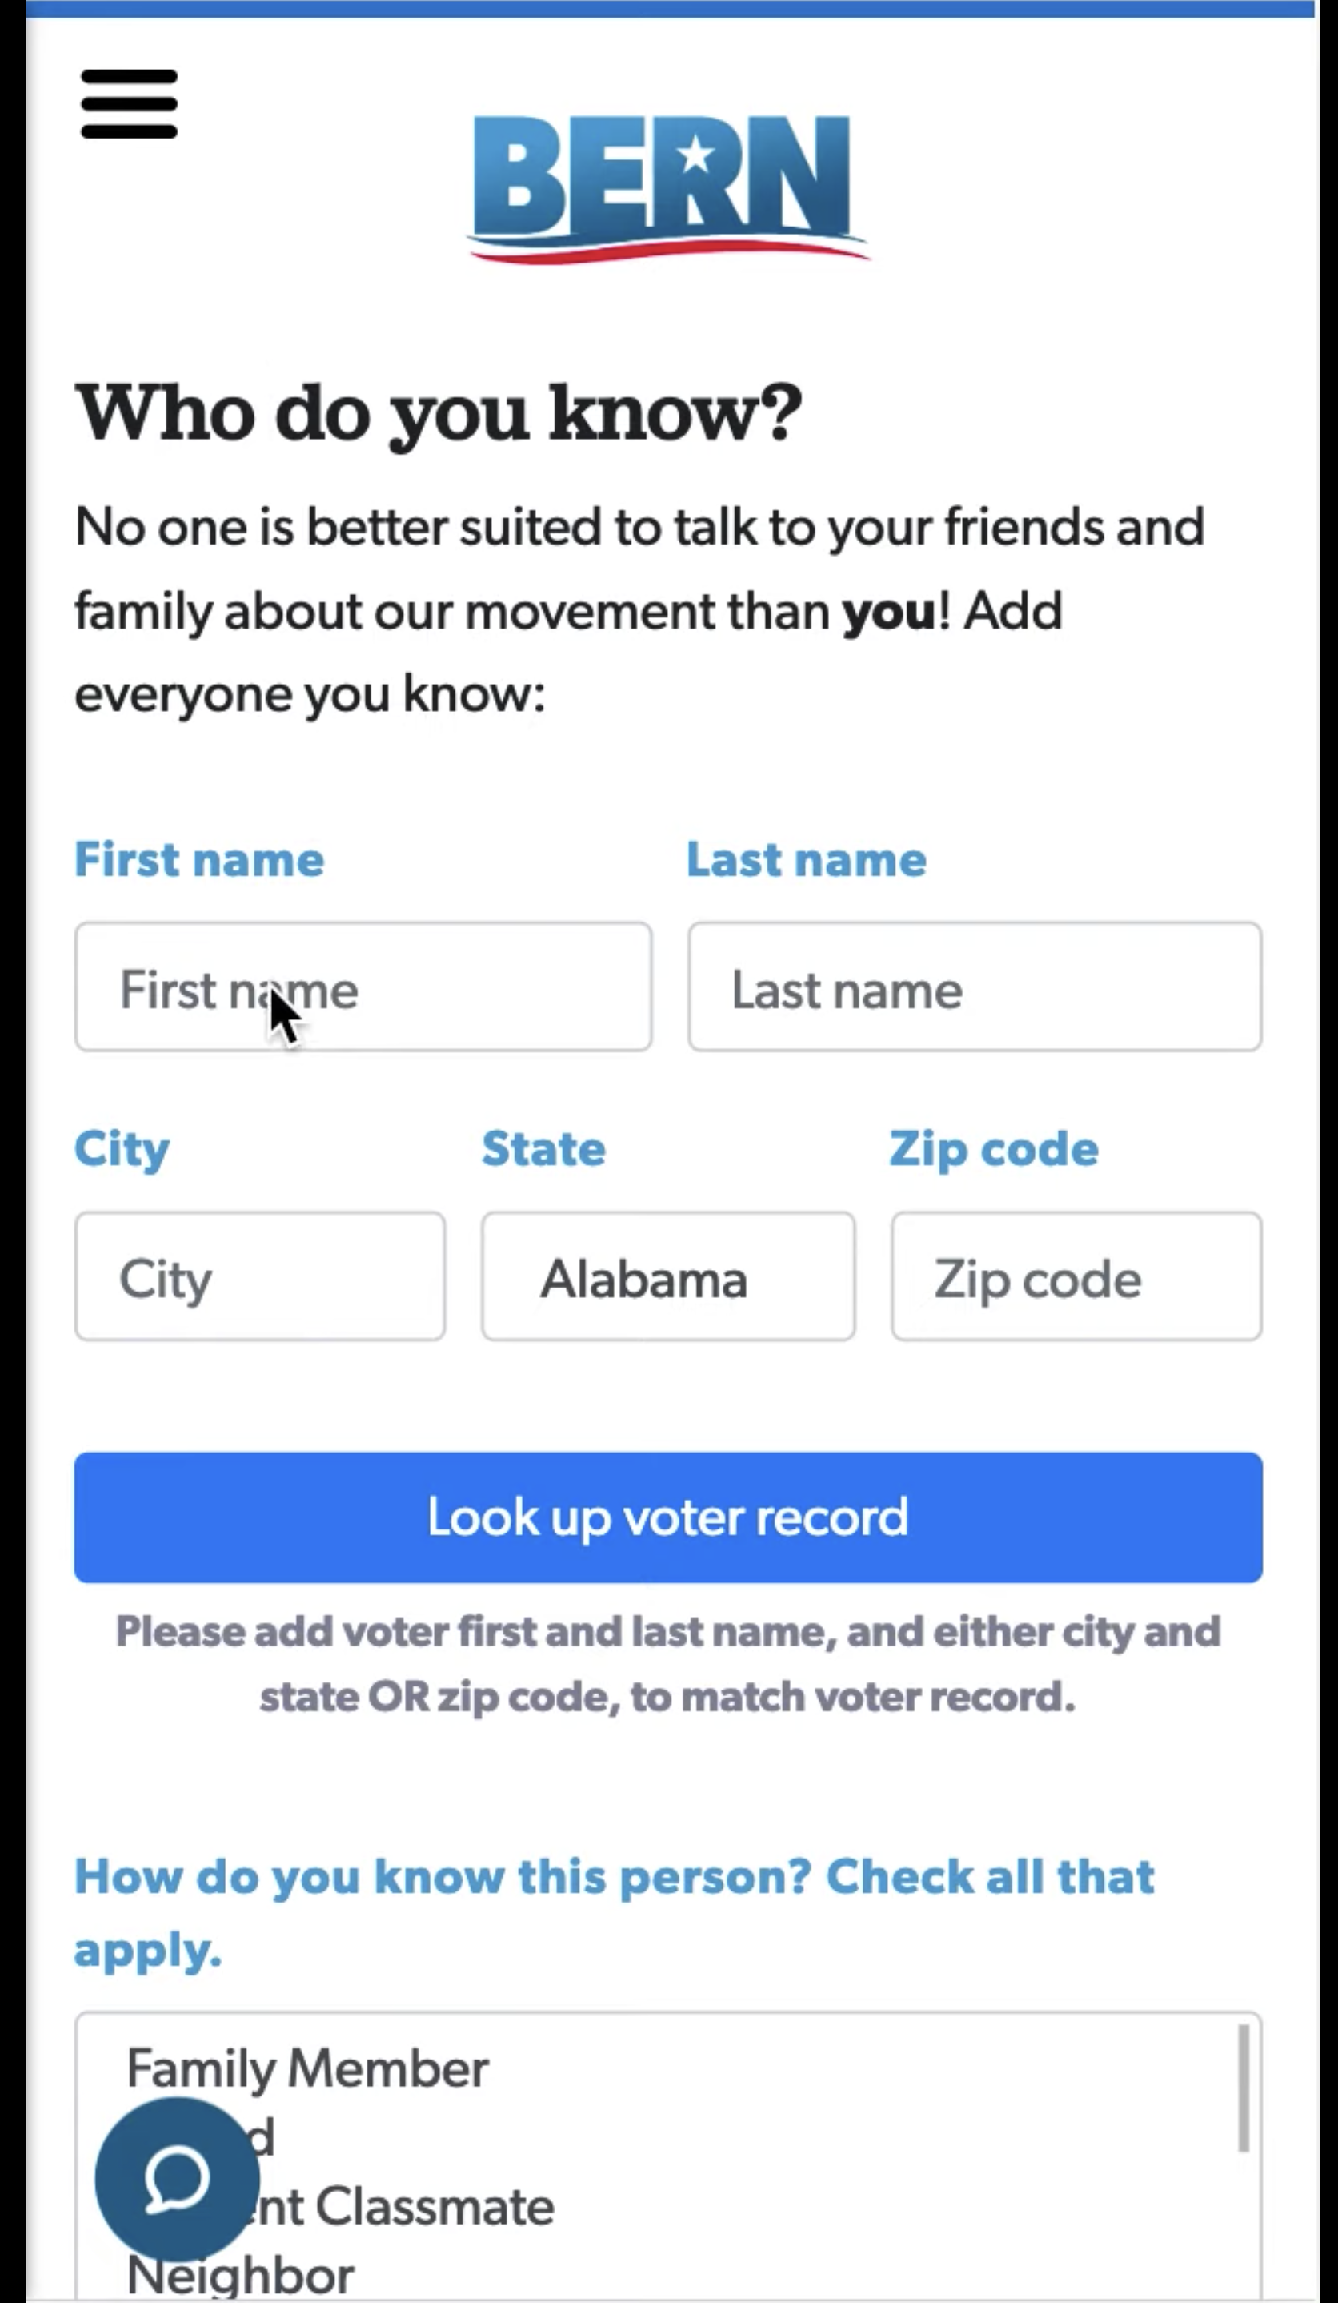
Political persuasion for undecided voters
Peer-to-peer persuasion
Goal: to social and peer pressure to augment your supporter base
Social influence shapes decisions (Granovetter, 1973)
People are often persuaded by those they personally interact with

Slide 11
Political microtargeting and personality traits
Microtargeting advertising
Based on the technological advances in computing and data analytics, (political) messages on social networking sites can now be tailored to fit the personality trait(s) of the recipients, and subsequently microtargeted to specific target audiences (Zarouali et al., 2021)
Big-five personality traits (OCEAN)
Openness (to Experience): willingness to try new things and think outside of the box.
Conscientiousness: ability to control impulses and actions in a socially acceptable manner.
Extroversion: extroverts vs. introverts - how a person draws energy and interacts with others.
Agreeableness: how well people get along and interact with others
Neuroticism: based on how confident a person is in their own skin
Other personality traits:
Need for cognition, susceptibility to consensus/authority/consensus
Dark triads: narcissism, Machiavellianism, and psychopathy.

Slide 12
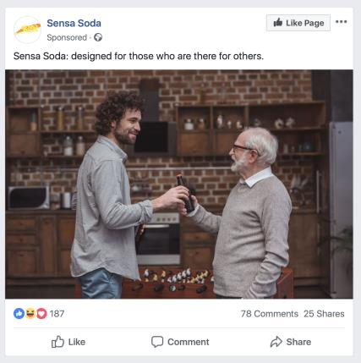
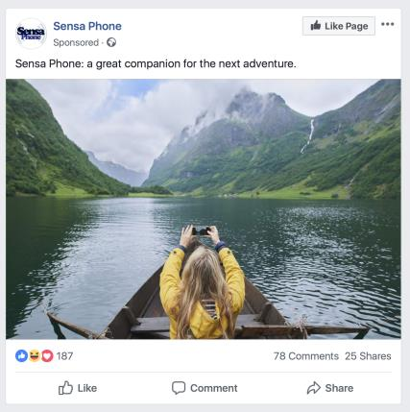

Political microtargeting and personality traits
Agreeableness
Openness
Extraversion
Source: Winter et al., 2021; Peng & Wang, 2022

Slide 13
Political microtargeting and personality traits
Self-congruity theory
Individuals prefer external stimuli when they are congruent with their own self-concept (Aaker, 1999).
Congruent ads (i.e., ads that contain text that coincides with someone’s self-concept) are more effective than incongruent ads because they increase personal relevance (Hong & Zinkhan, 1995)
Zarouali et al. (2021)
People are more persuaded when they receive a political ad containing a text that is tailored based on data relating to their psychological make-up (introverted or extraverted).
Congruity effect can be established when emotional appeals align with people’s personality: introverted people generated higher voting intentions when they were targeted with a negative fear-based political ad, whereas extraverted citizens had higher voting intentions after receiving a positive enthusiasm-based political ad.

Slide 14
Reference
Aaker, J. L. (1999). The malleable self: The role of self-expression in persuasion. Journal of marketing research, 36(1), 45-57. https://doi.org/10.1177/002224379903600104
Feinberg, M., & Willer, R. (2015). From gulf to bridge: When do moral arguments facilitate political influence?. Personality and Social Psychology Bulletin, 41(12), 1665-1681. https://doi.org/10.1177%2F0146167215607842
Hong, J. W., & Zinkhan, G. M. (1995). Self-concept and advertising effectiveness: The influence of congruency, conspicuousness, and response mode. Psychology & Marketing, 12(1), 53–77. https://doi.org/10.1002/mar.4220120105
O’Keefe, D. J. (1999). How to handle opposing arguments in persuasive messages: A meta-analytic review of the effects of one-sided and two-sided messages. Annals of the International Communication Association, 22(1), 209-249. https://doi.org/10.1080/23808985.1999.11678963
Peng, R. X. & Wang, R. Y. (2022). Targeting and Tailoring: investigating the effects of trait-congruent personalized health campaign on social media. Working paper.
Perloff, R. (2020). The Dynamics of Persuasion: Communication and Attitudes in the 21st Century. Taylor & Francis Group.
Simon, H. W. (1976). Persuasion: Understanding, Practice, and Analysis. Addison-Wesley Publishing Company.
Winter, S., Maslowska, E., & Vos, A. L. (2021). The effects of trait-based personalization in social media advertising. Computers in Human Behavior, 114. https://doi.org/10.1016/j.chb.2020.106525
Zarouali, B., Dobber, T., De Pauw, G., & de Vreese, C. (2020). Using a personality-profiling algorithm to investigate political microtargeting: Assessing the persuasion effects of personality-tailored ads on social media. Communication Research, online first. https://doi.org/10.1177%2F0093650220961965

